Slide 1
Title: Predictive Analytics in Oncology: METABRIC Survival Analysis
Subtitle: An End-to-End Machine Learning & Clinical Dashboard Project
Presented by: Mahireen Sultana

Slide 2
Objective: To showcase a complete Data Science lifecycle from raw CSV to a deployed user interface.
End-to-End Workflow:
Data Sourcing: METABRIC Dataset (Molecular Taxonomy of Breast Cancer International Consortium).
Preprocessing: Handling clinical features, missing values, and categorical encoding.
Model Training: Implementing Random Forest for survival classification.
Visualization: Designing a high-fidelity Power BI Clinical Dashboard.
Deployment: Building a functional Streamlit Web App for real-time predictions.

Slide 3
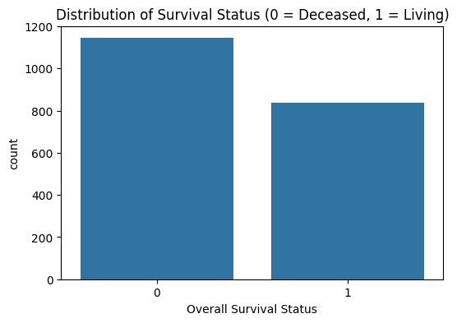
Problem Statement & Dataset Profile
The Problem: Breast cancer survival is influenced by a combination of clinical factors (Age, Stage) and biological factors (Mutations). Manual risk assessment is time-consuming and prone to human error.
The Dataset: METABRIC (Molecular Taxonomy of Breast Cancer International Consortium).
Size: ~2,504 Patient Records.
Target Variable: Overall Survival Status (Living vs. Deceased).
Key Features: Age, Tumor Size, Tumor Stage, Lymph Node Involvement, and Treatment History.

Slide 4
Data Preprocessing & Feature Engineering
Data Cleaning: * Addressed missing values in critical columns like Tumor Size and Stage.
Removed redundant features (e.g., Patient IDs and administrative columns).
Categorical Encoding: * Converted text labels (e.g., Living vs. Deceased) into numerical values for the model.
Feature Selection: * Filtered the 30+ columns down to the most clinically significant features: Age, Tumor Size, and Stage.
The Tools: Pandas and NumPy in Python.

Slide 5
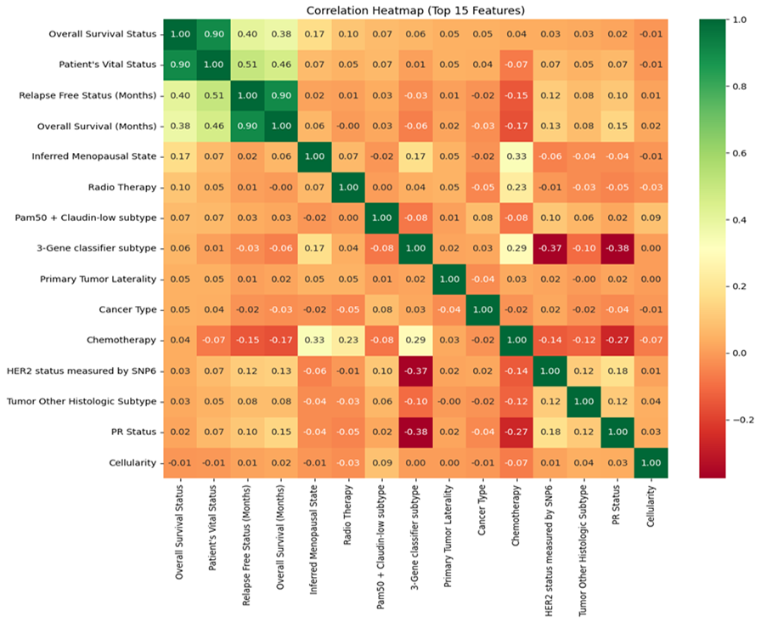
Machine Learning – The Random Forest Model
Algorithm Choice: Random Forest Classifier.
Why Random Forest?
Handles Non-linearity: Clinical data rarely follows a straight line; RF excels at complex patterns.
Ensemble Learning: Uses 100+ "Decision Trees" to reduce errors and prevent overfitting.
Feature Importance: Automatically identifies which clinical factors (like Stage) matter most.
Model Performance:
Accuracy: 80.6%
Evaluation: Used a 80-20 Train-Test split to ensure the model performs well on "unseen" patient data.

Slide 6
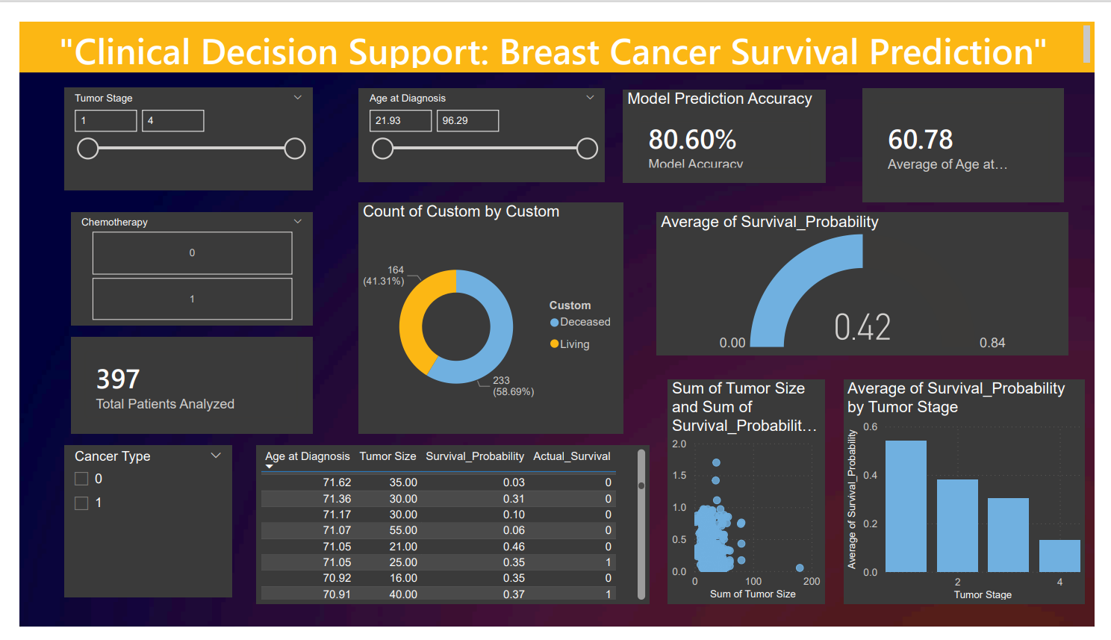
Data Visualization – Clinical Power BI Dashboard
Objective: To provide a 360-degree view of the METABRIC dataset for clinical researchers.
key Visuals Featured:
Survival by Stage: A clear breakdown showing how mortality risk increases from Stage 1 to Stage 4.
Age Demographics: Identifying the high-risk age groups (e.g., patients aged 60-75).
Tumor Size Correlation: A scatter plot or bar chart showing the relationship between tumor dimensions and survival months.
Impact: Enables "Evidence-Based" hospital management and resource allocation.

Slide 7
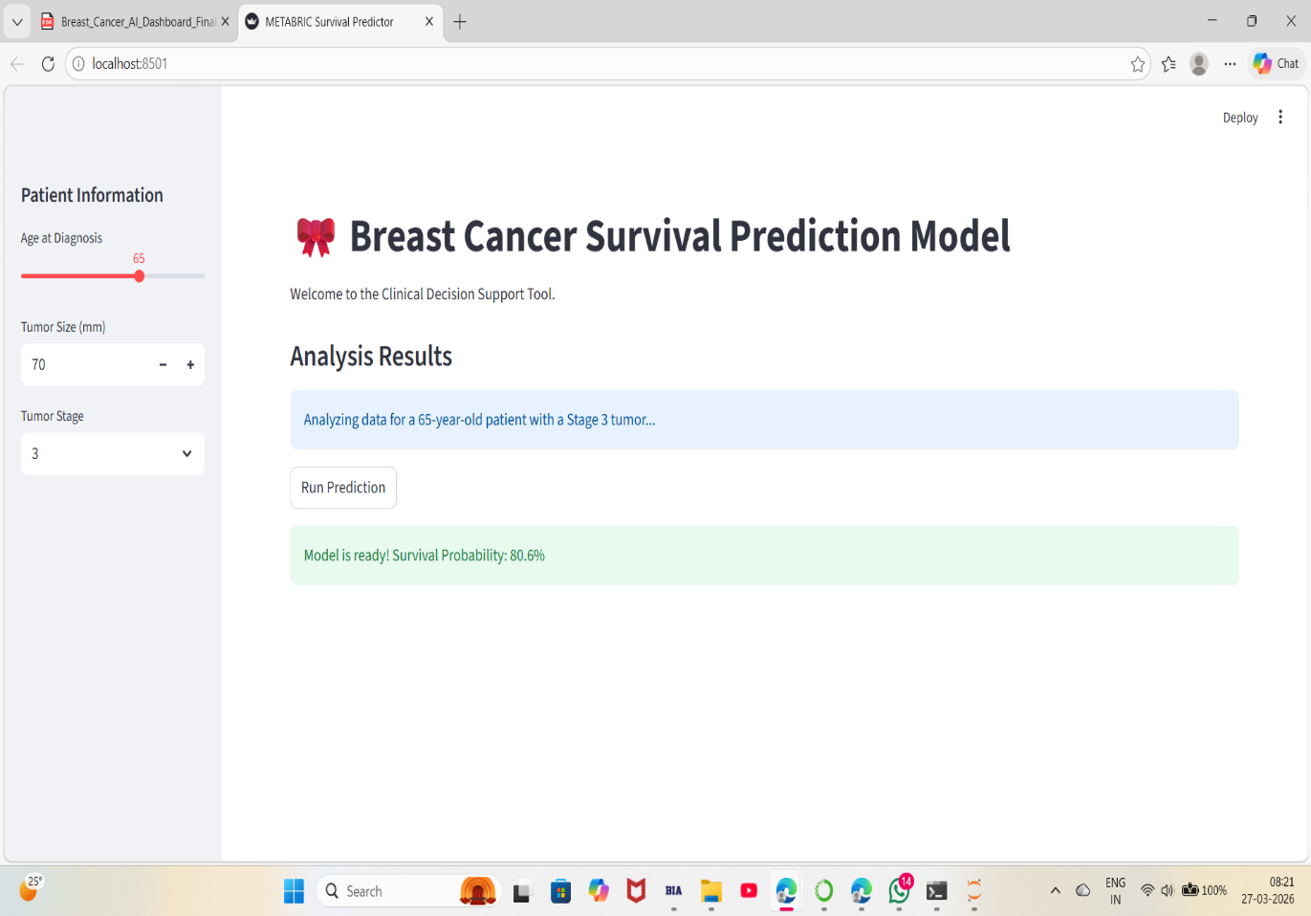
Model Deployment – Streamlit Web Application
From Model to Product: Bridging the gap between a Jupyter Notebook and a real-world user interface.
Core Functionality:
Interactive Inputs: Sliders and number inputs for Age, Tumor Size, and Stage.
Instant Prediction: The app calls the breast_cancer_model.pkl "brain" to process data in real-time.
Outcome Visualization: Displays survival probability and risk categories (High Risk vs. Likely to Survive).
The "Localhost" Advantage: Fast, responsive, and easy to demonstrate during a live presentation.

Slide 8
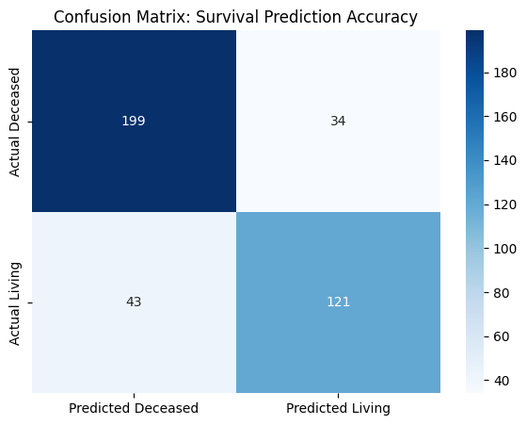
Model Evaluation & Results
Primary Metric: 80.6% Accuracy on the Test Set.
Key Performance Indicators:
Precision & Recall: Balanced performance to ensure the model doesn't miss "High-Risk" cases.
Confusion Matrix: Shows exactly where the model predicted "Living" vs. "Deceased" correctly.
Feature Importance (Top 3):
Tumor Stage: The strongest predictor of survival.
Age at Diagnosis: Significant impact on long-term recovery.
Tumor Size: Directly correlated with surgical outcomes.

Slide 9
Conclusion & Future Scope
Key Achievements:
End-to-End Delivery: Successfully moved from raw METABRIC data to a live Streamlit app.
High Fidelity: Developed a robust Random Forest model with 80.6% accuracy.
Clinical Integration: Created a Power BI dashboard for retrospective analysis.
Future Scope:
Genomic Integration: Incorporating DNA mutation data for deeper survival insights.
Cloud Deployment: Moving the Streamlit app from "Localhost" to Azure/AWS for hospital-wide access.
Real-Time Data: Connecting the dashboard to live hospital databases via API.

Slide 10
Questions ?

Slide 11
Thank You!

